Slide 1
DSS Stakeholders’s Workshop
CS2 Drought Prototype

Slide 2
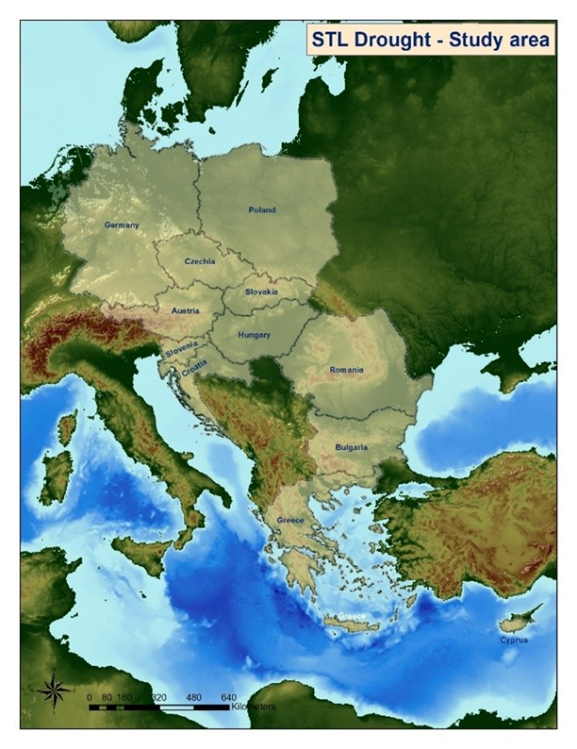
CS2 - Drought
Main challenge:
Comprehensive assessment of drought hazard and impact dimensions in selected climate change hotspot areas, translated into actionable knowledge
Study area:
Central and South-Eastern Europe;
Selected climate change hotspots in 5 countries (Austria, Czech Republic, Germany, Poland, Romania)

Slide 3
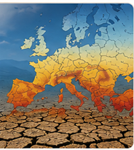


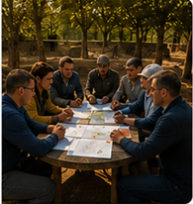
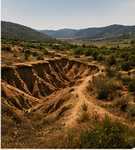

CS2 - Drought
Key directions of study
Drought characteristics in present and future climate
Subjective perception of social and gender dimension of drought impact
Stakeholders’ views on drought-related impact and adaptation options
Social vulnerability assessment
Land degradation as drought impact
Policies

Slide 4

CS2 - Drought
Key results
Significant increase in drought hazard intensity, especially towards the late 21st century in southern and western Europe.
The overall impact of drought is perceived as being the highest on people living in rural areas, as well as on people with chronic medical conditions.
Stakeholders identify agriculture and water as the most affected sectors.
Selected hotspots differ in relation to social vulnerability
Stakeholders emphasize the efficiency of financial mechanisms for increasing the resilience of agriculture to drought, e.g., subsidies for irrigation systems, support for R&D in agriculture.
The negative impact of drought on land quality is generally limited and spatially dispersed.

Slide 5
CS2 - Drought
DSS – Exploratory module:
Provides full datasets developed in CS2
Allows a more in-depth/customized analysis
Covers:
HAZARD
EXPOSURE
VULNERABILITY
IMPACT dimensions

Slide 6
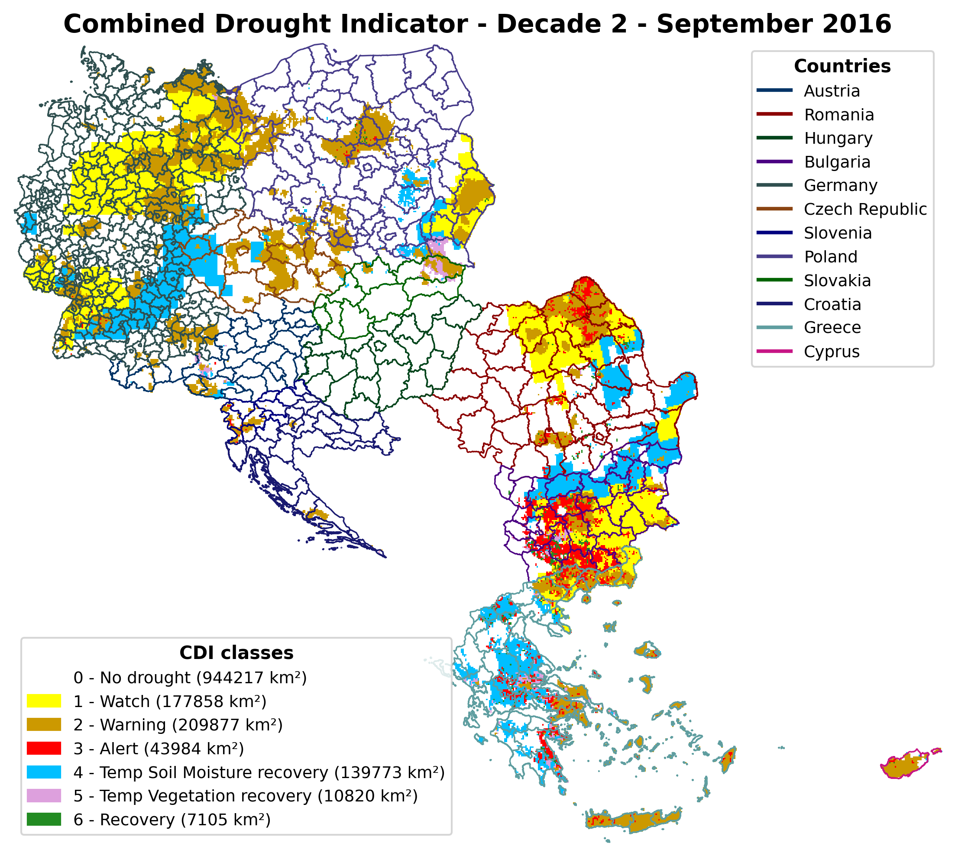
CS2 - Drought
DSS – Exploratory module:
HAZARD
Present climate
- Satellite data
- Use of Climate Drought Index (CDI)
- 2012-2025
Future climate:
Use of scPDSI (Self-Calibrated Palmer Drought Severity Index)
Climate projections – ensemble of 9 models
RCP45 &RCP85
2011-2040; 2041-2070; 2071-2100
4 drought intensity classes (mild, moderate, severe, extreme)
Statistical measures

Slide 7
CS2 - Drought
DSS – Exploratory module:
EXPOSURE
VULNERABILITY
IMPACT
Population density
Risk of poverty
Education level
Labor force employed in agriculture
Household income
Social Vulnerability Index
Ecosystems (land degradation)
Social and gender aspects
Capabilities/life aspects more impacted by drought

Slide 8
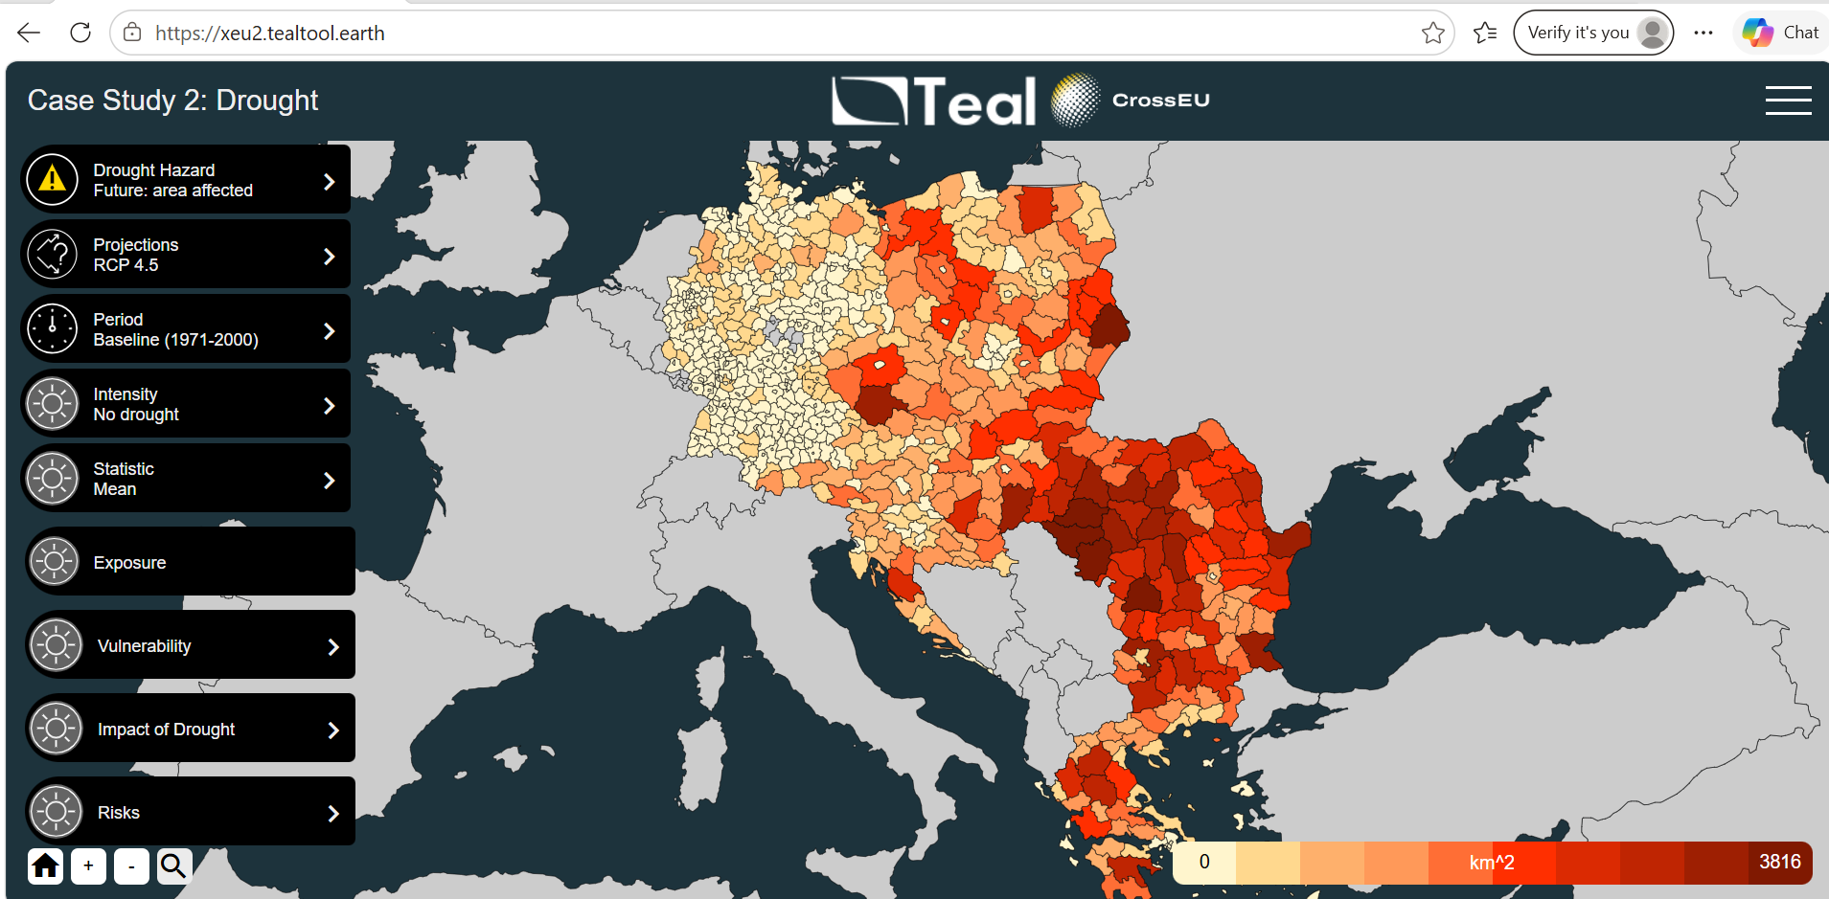

Slide 9
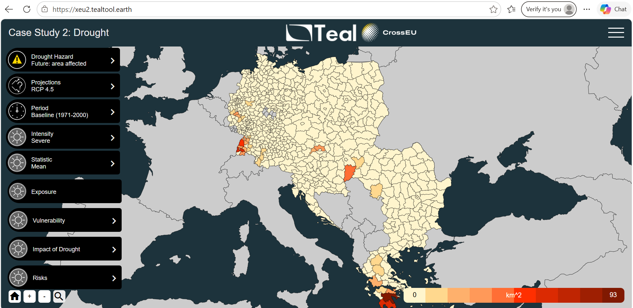

Slide 10
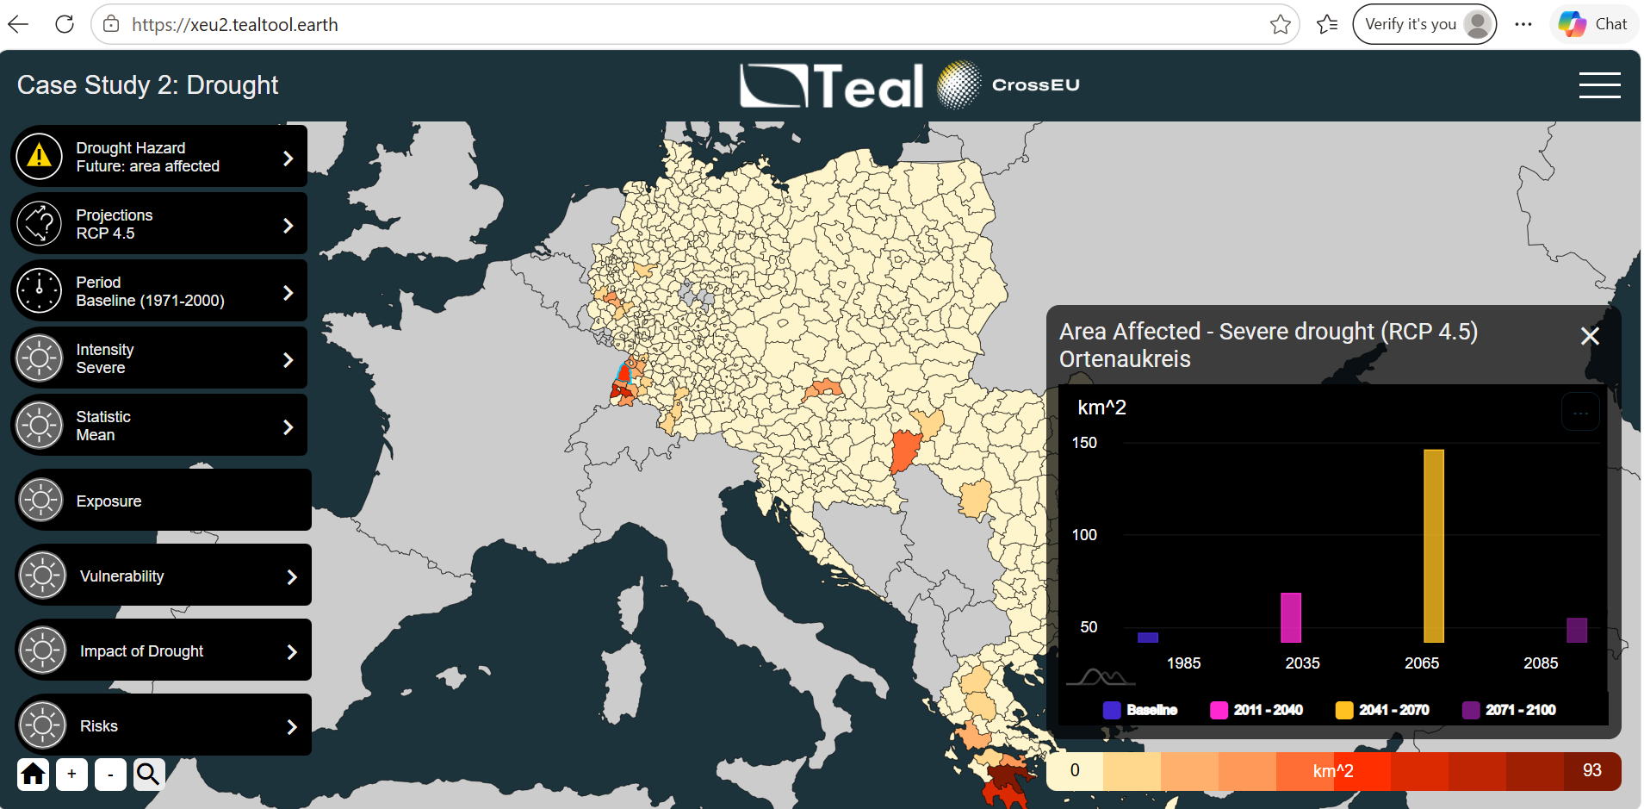

Slide 11
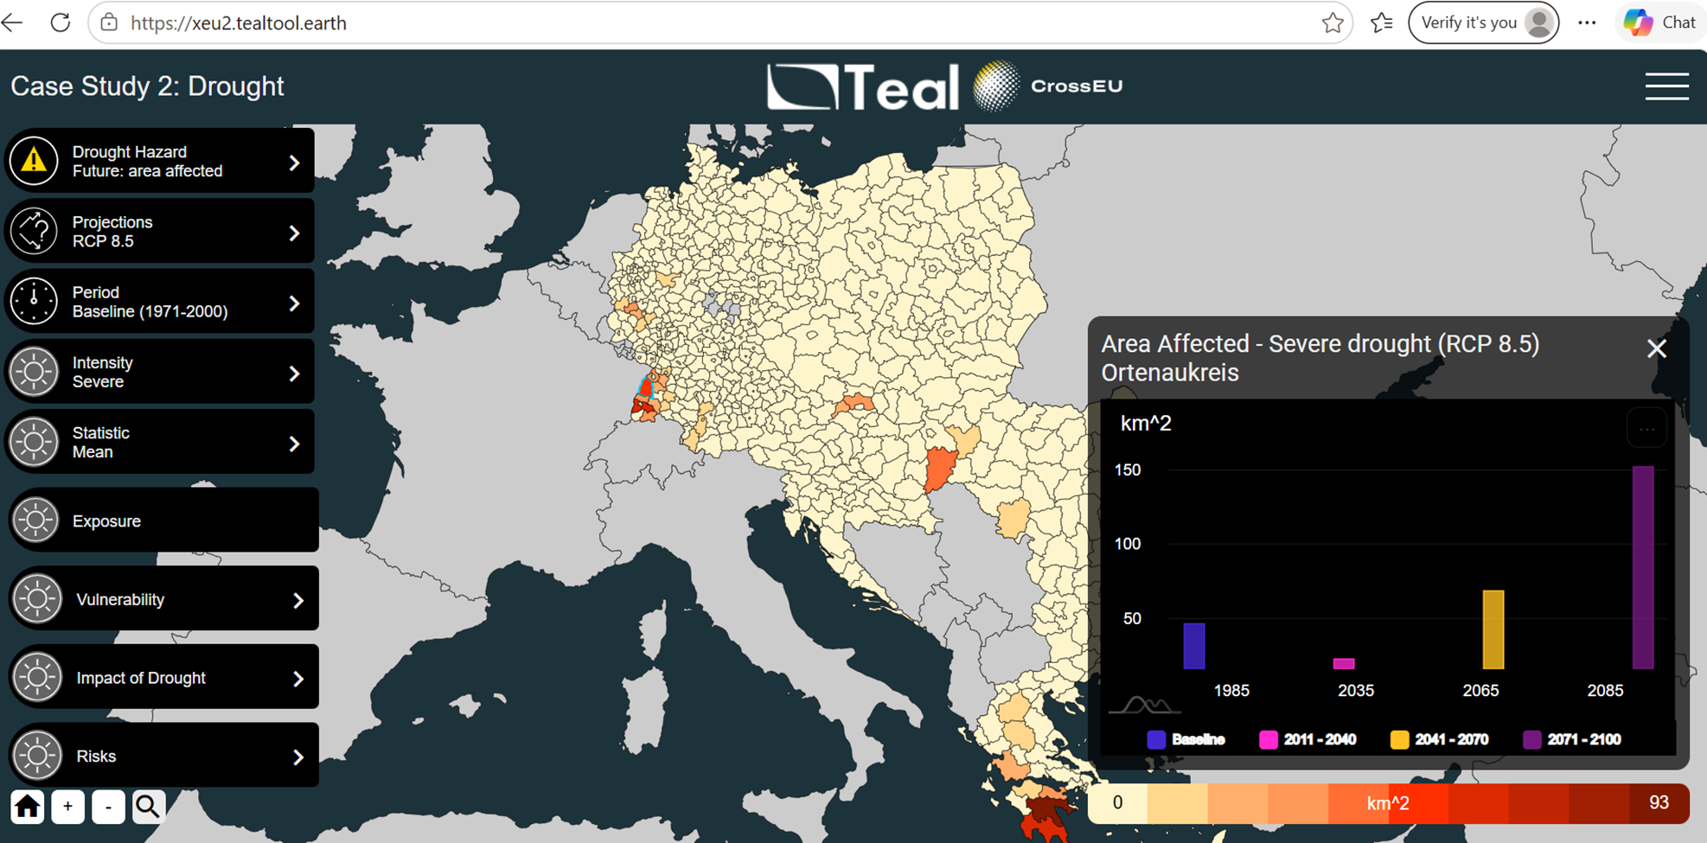

Slide 12
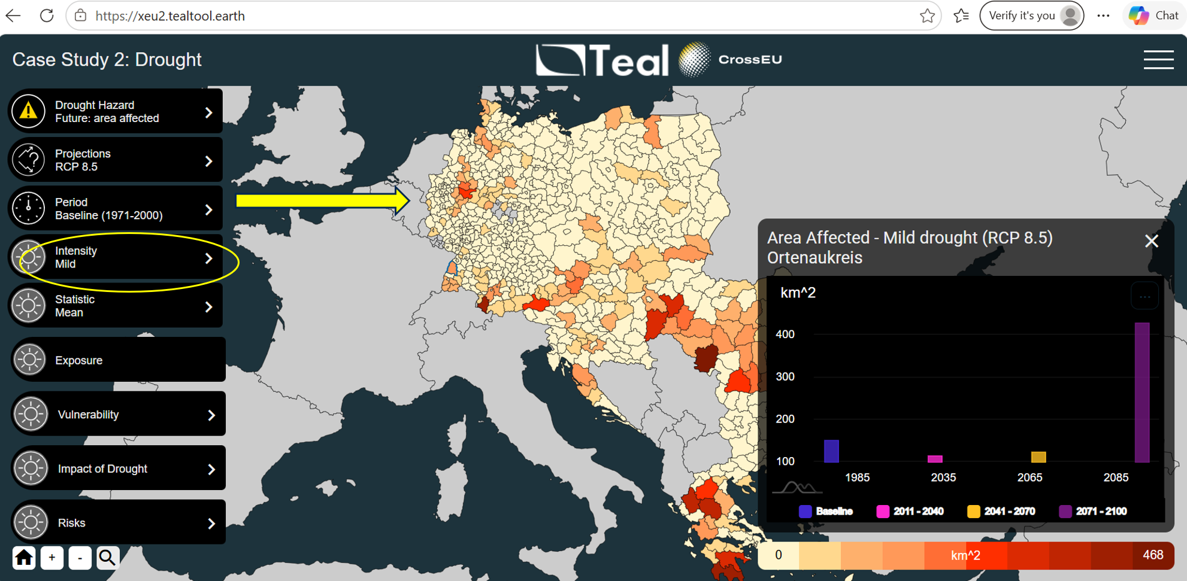

Slide 13
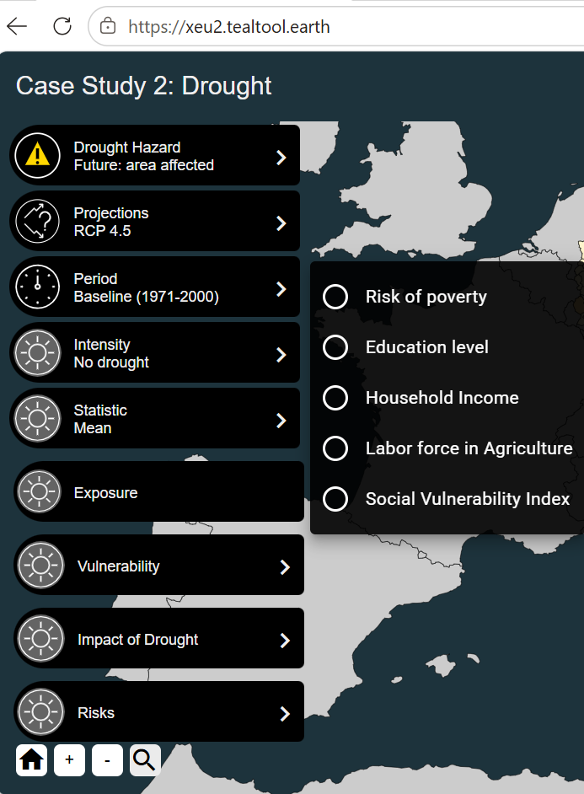
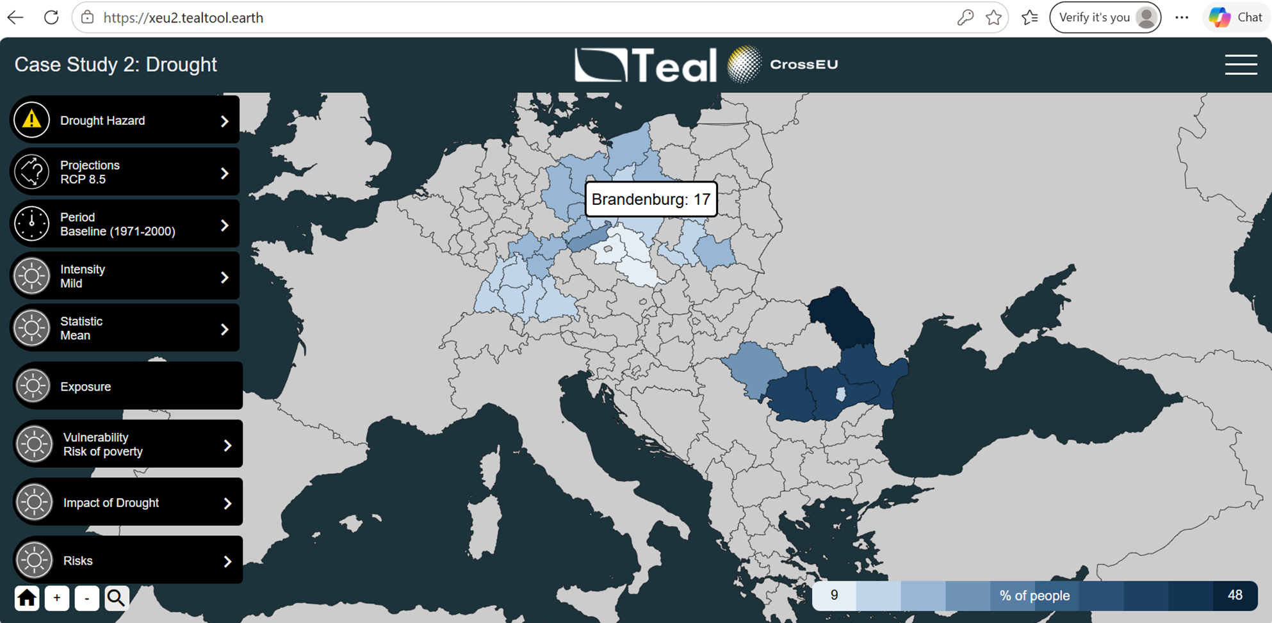
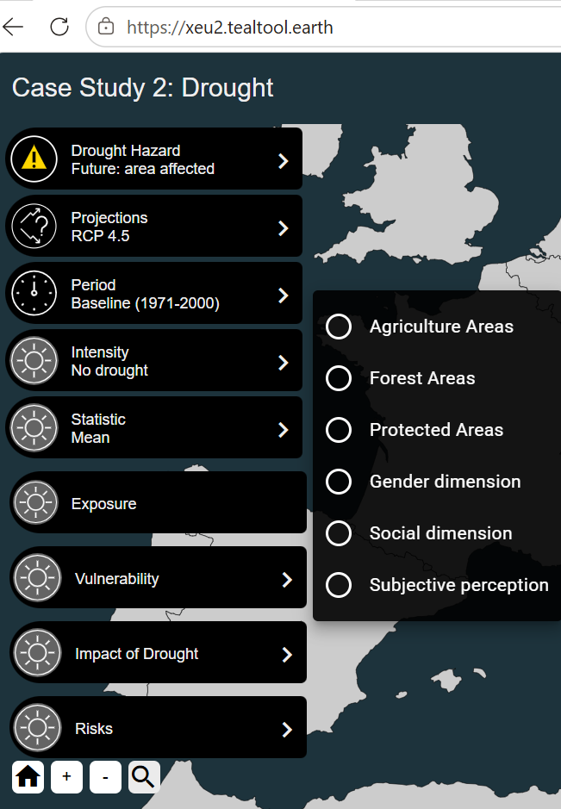
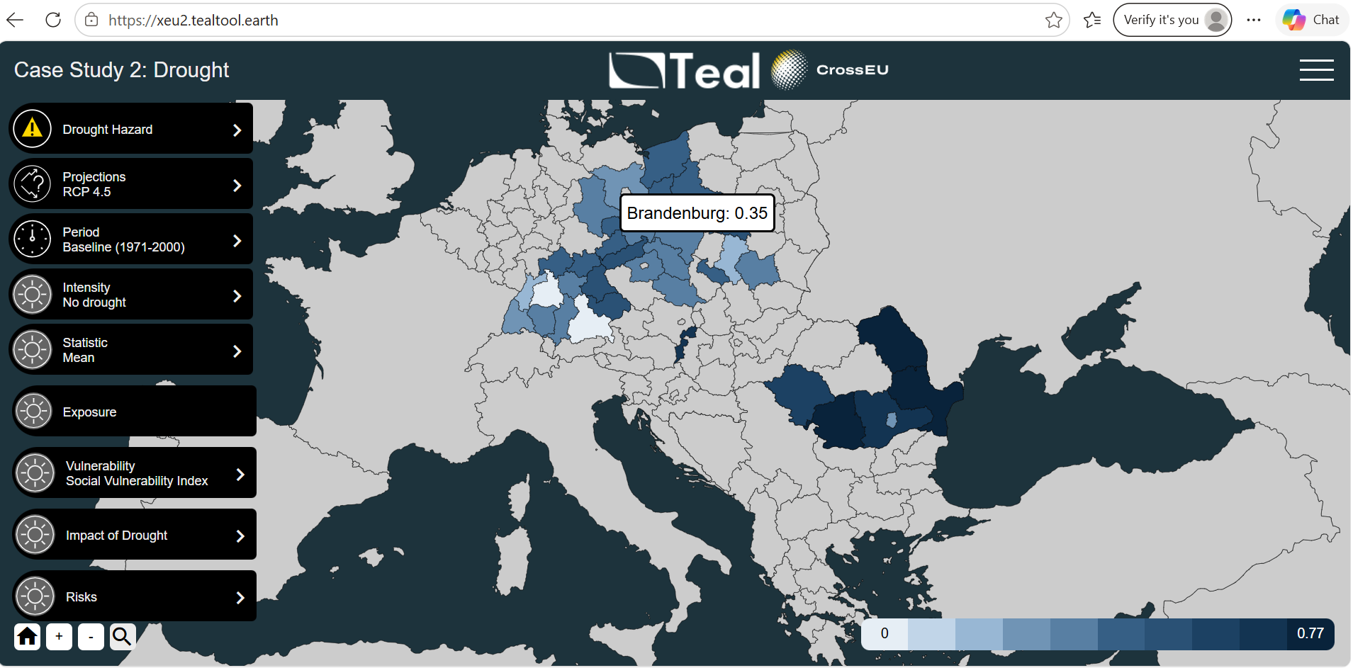
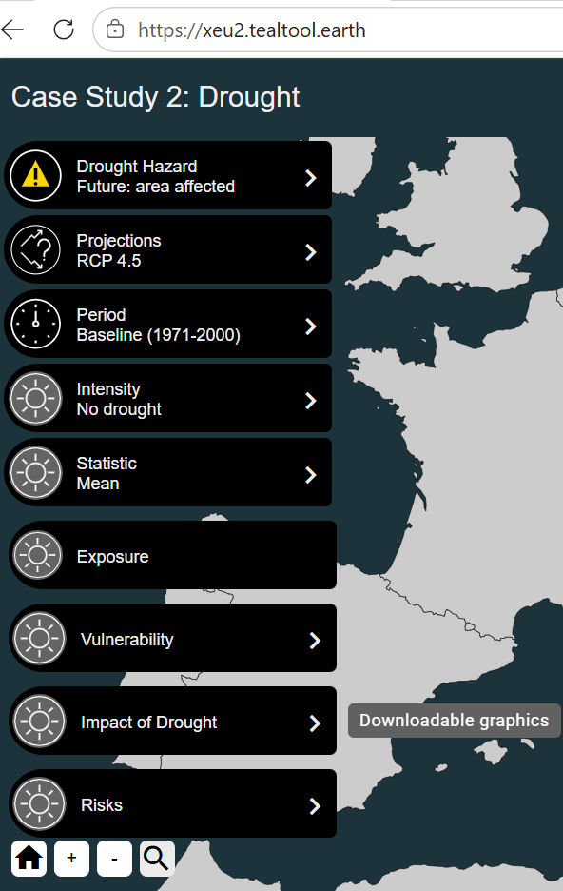
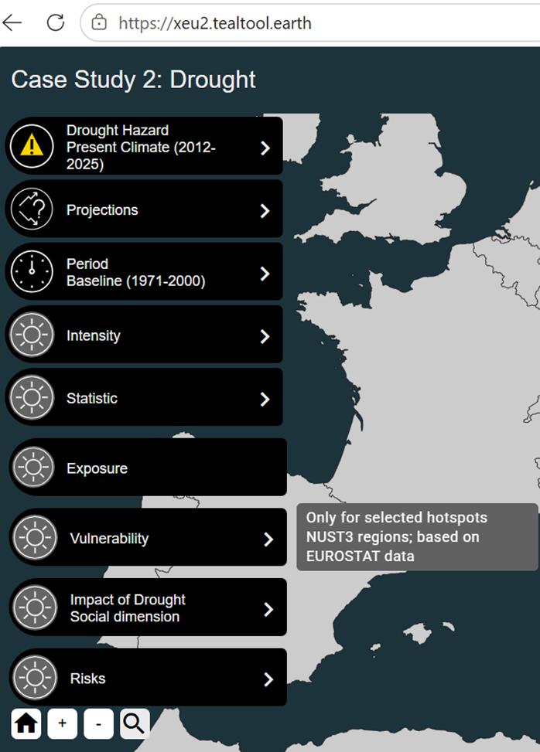
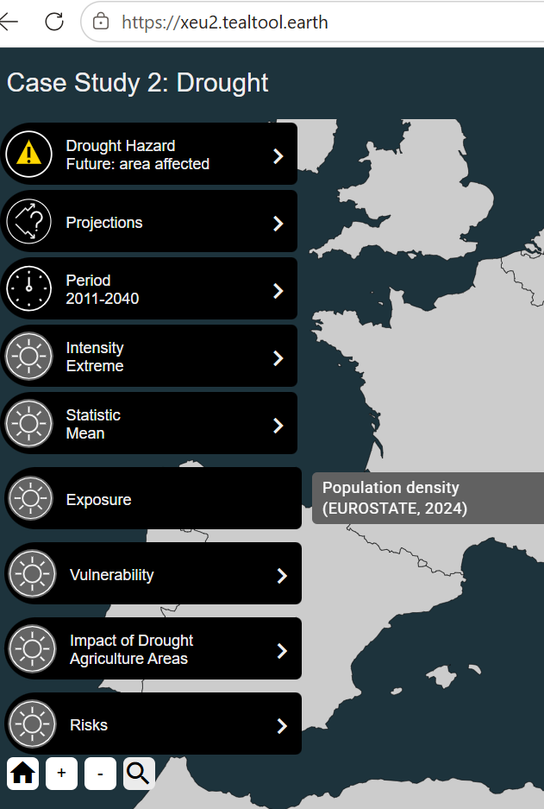

Slide 14
CS2 - Drought
Next: DSS – Question-based module
Provides customized, ready-to-use information
Supports informed decision
Covers similar aspects as the Exploratory module
2011-2040
Category | Question
Hazard (climate signal) | How will drought intensity change in my area by 2040/2070/2100?
 | What area will be affected by (different intensity) of drought?
 | What was the extent and intensity of drought during recent period (2018-2023) and during the last years (2012-2025)?
Exposure (what is located in harm’s way?): | How many people might be affected by drought effects?
Vulnerability (who/what is most sensitive?) | In which (NUTS2) region people are more vulnerable to drought and why?
Prioritization and planning | Where (NUTS2) should we invest first?
Impact | How was the overall quality of the land in agricultural/forest/protected areas affected by drought in the last years?
2041-2070
2071-2100
Hazard levels in the future climate relative to the present climate, expressed through the share of NUTS3 area affected by at least ‘mild’ drought.

Slide 15
Thank you

